Slide 1
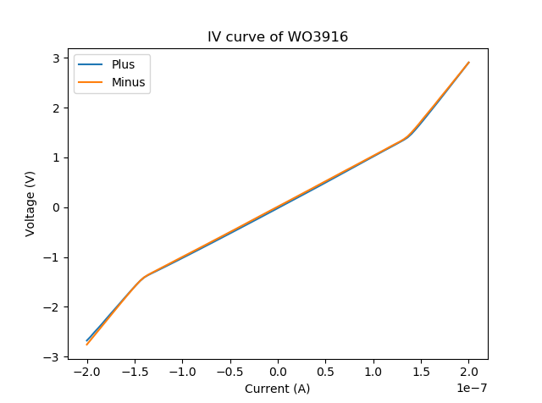
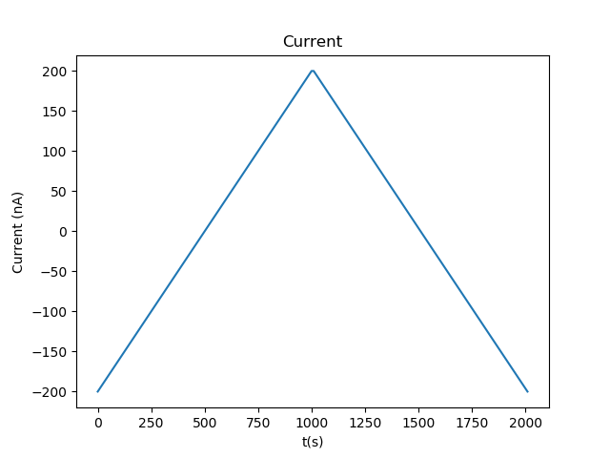
IV curve of WO3196 Dev2
0117_1703_WO3196_full_IV_curve
Sample rate is 0.1 Hz
Measurement time is 2020.0 s
Limit voltage starts at 10.0 V
Devices connected
Setup completed
Start measurement at 2020-01-17 17:03:46.197799
And takes 33.67 minutes
Measurement done
Mean resistance is nan with std nan
101 steps per IV curve
Max source was 200 nA
Sample time was 10 PLC (got from script)

Slide 2
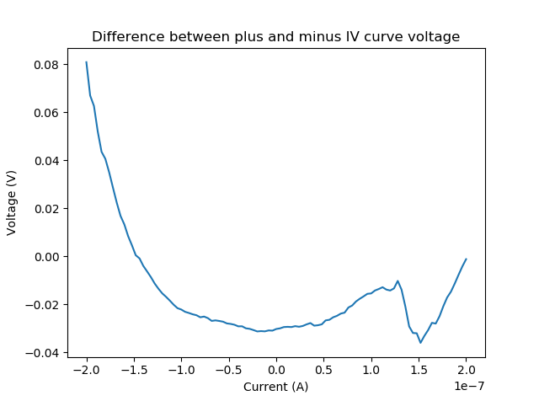
Difference between IV curves
No clear relation, except that points fartest apart in time have the largest difference (calculated by flipping voltage_minus around and subtracting it from voltage_plus)

Slide 3
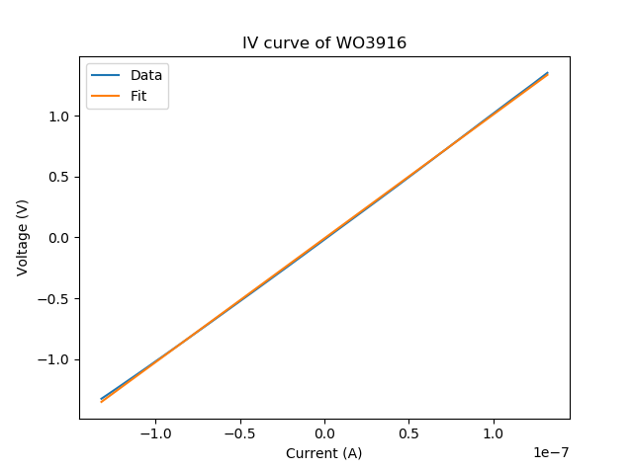
Knee location
Similar for both curves and current values at approximately (+/- 1.5V and +/-1.5E-7 A, or the 15th value of the array)

